Slide 1
Decision Trees and Boosting for Classification and Regression

Slide 2
Hierarchy of Ensemble Methods for Trees
Classiﬁcation Trees
• Bagging: Averaging Trees
• Random Forests: Cleverer Averaging of Trees
• Boosting: Cleverest Averaging of Trees
Methods for improving the performance of weak learners such as Trees. Classiﬁcation trees are adaptive, but do not generalize well.

Slide 3
Types of ensemble methods
parallel ensemble methods where the base learners are generated in parallel (e.g. Bagged Trees, Random Forest). The basic motivation of parallel methods is to exploit independence between the base learners since the error can be reduced dramatically by averaging.
sequential ensemble methods where the base learners are generated sequentially (e.g. Boosting). The basic motivation of sequential methods is to exploit the dependence between the base learners. The overall performance can be boosted by weighing previously mislabeled examples with higher weight.

Slide 4
Ensemble Methods
Most ensemble methods use a single base learning algorithm to produce homogeneous base learners, i.e. learners of the same type, leading to homogeneous ensembles.
There are also some methods that use heterogeneous learners, i.e. learners of different types, leading to heterogeneous ensembles. In order for ensemble methods to be more accurate than any of its individual members, the base learners have to be as accurate as possible and as diverse as possible.

Slide 5
Decision tree are the best for ensemble learning
Decision tree learning algorithms produce accurate models that can be interpreted by domain experts. However, these algorithms are known to be unstable – they can produce drastically different results from training sets that differ just slightly.
Combining stable learners is less advantageous since the ensemble will not help improve generalization performance. the objective of extracting knowledge from the trees.

Slide 6
Classification Trees
Observations are classiﬁed into two or more classes, coded by a response variable Y taking values 1,2, ...,K.
• We have a vector of observations X =(X₁,X₂,...,X_{p}),and we hope to build a classiﬁcation rule C(X) to assign a class label to an individual with feature X.
• We have a sample of pairs (y_{i},x_{i}), i=1,...,N.
Note that each of the x_{i} are vectors x_{i} =(x_{i1},x _{i2},...,x_{ip}).

Slide 7
Classification Trees
Represented by a series of binary splits.
• Each internal node represents a value query on one of the variables—e.g. “Is X3 > 0.4”.If the answeris“Yes”,go right, else go left.
• The terminal nodes are the decision nodes. Typically, each terminal node is dominated by one of the classes.
• The tree is grown using training data, by recursive splitting.
• The tree is often pruned to an optimal size, evaluated by cross-validation.
• New observations are classiﬁed by passing their X down to a terminal node of the tree, and then using majority vote.

Slide 8
✔ Can handle huge data sets
✔ Can handle mixed predictors—quantitative and qualitative
✔ Easily ignore redundant variables
✔ Handle missing data elegantly
✔ Small trees are easy to interpret
✖ large trees are hard to interpret
✖ Often prediction performance is poor

Slide 9
Classification trees
Classiﬁcation trees can be simple, but often produce noisy(bushy) or weak(stunted)classiﬁers.
• Bagging (Breiman,1996):Fit many large trees to bootstrap-resampled versions of the training data, and classify by majority vote.
• Boosting (Freund&Shapire,1996): Fit many large or small trees to reweighted versions of the training data. Classify by weighted majority vote.
• Random Forests (Breiman1999):Fancier version of bagging. In general Boosting > Random Forests > Bagging > Single Tree.

Slide 10
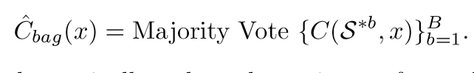
Bagging
Bagging or bootstrap aggregation averages a given procedure over many samples to reduce its variance.
Suppose C(S,x) is a classiﬁer, such as a tree, based on our training data S, producing a predicted class label at input point x. To bag C, we draw bootstrap samples S^{∗1},...S^{∗B} each of size N with replacement from the training data. Then
Bagging can dramatically reduce the variance of unstable procedures (like trees), leading to improved prediction. However any simple structure in C (e.g a tree) is lost.
Bagging averages many trees, and produces smoother decision boundaries.

Slide 11
Bagging
Out-of-Bag Error Estimation
It turns out that there is a very straightforward way to estimate the test error of a bagged model, without the need to perform cross-validation or the validation set approach.
In bagging trees are repeatedly ﬁt to bootstrapped subsets of the observations. One can show that on average, each bagged tree makes use of around two-thirds of the observations. The remaining one-third of the observations not used to ﬁt a given bagged tree are referred to as the out-of-bag (OOB) observations. We can predict the response for the ith observation using each of the trees in which that observation was OOB. This will yield around B/3 predictions for the i-th observation, where B is the number of trees.
In order to obtain a single prediction for the ith observation, we can take a majority vote (if classiﬁcation is the goal). This leads to a single OOB prediction for the i-th observation. An OOB prediction can be obtained in this way for each of the n observations, from which the overall OOB MSE (for a regression problem) or classiﬁcation error (for a classiﬁcation problem) can be computed. The resulting OOB error is a valid estimate of the test error for the bagged model, since the response for each observation is predicted using only the trees that were not ﬁt using that observation.

Slide 12
Random Forests
Reﬁnement of bagged trees; quite popular
• at each tree split, a random sample of m features is drawn, and only those m features are considered for splitting. Typically m =√p or log2 p, where p is the number of features
• For each tree grown on a bootstrap sample, the error rate for observations left out of the bootstrap sample is monitored. This is called the “out-of-bag” error rate.
• random forest tries to improve on bagging by “de-correlating” the trees. Each tree has the same expectation

Slide 13
Boosting
Boosting refers to a family of algorithms that are able to convert weak learners to strong learners. The main principle of boosting is to fit a sequence of weak learners− models that are only slightly better than random guessing, such as small decision trees− to weighted versions of the data. More weight is given to examples that were misclassified by earlier rounds.
The predictions are then combined through a weighted majority vote (classification) or a weighted sum (regression) to produce the final prediction. The principal difference between boosting and the committee methods, such as bagging, is that base learners are trained in sequence on a weighted version of the data.

Slide 14
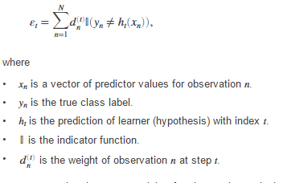
Boosting
AdaboostM1 is a very popular boosting algorithm for binary classification. The algorithm trains learners sequentially.
For every learner with index t AdaboostM1 computes the weighted classification error

Slide 15


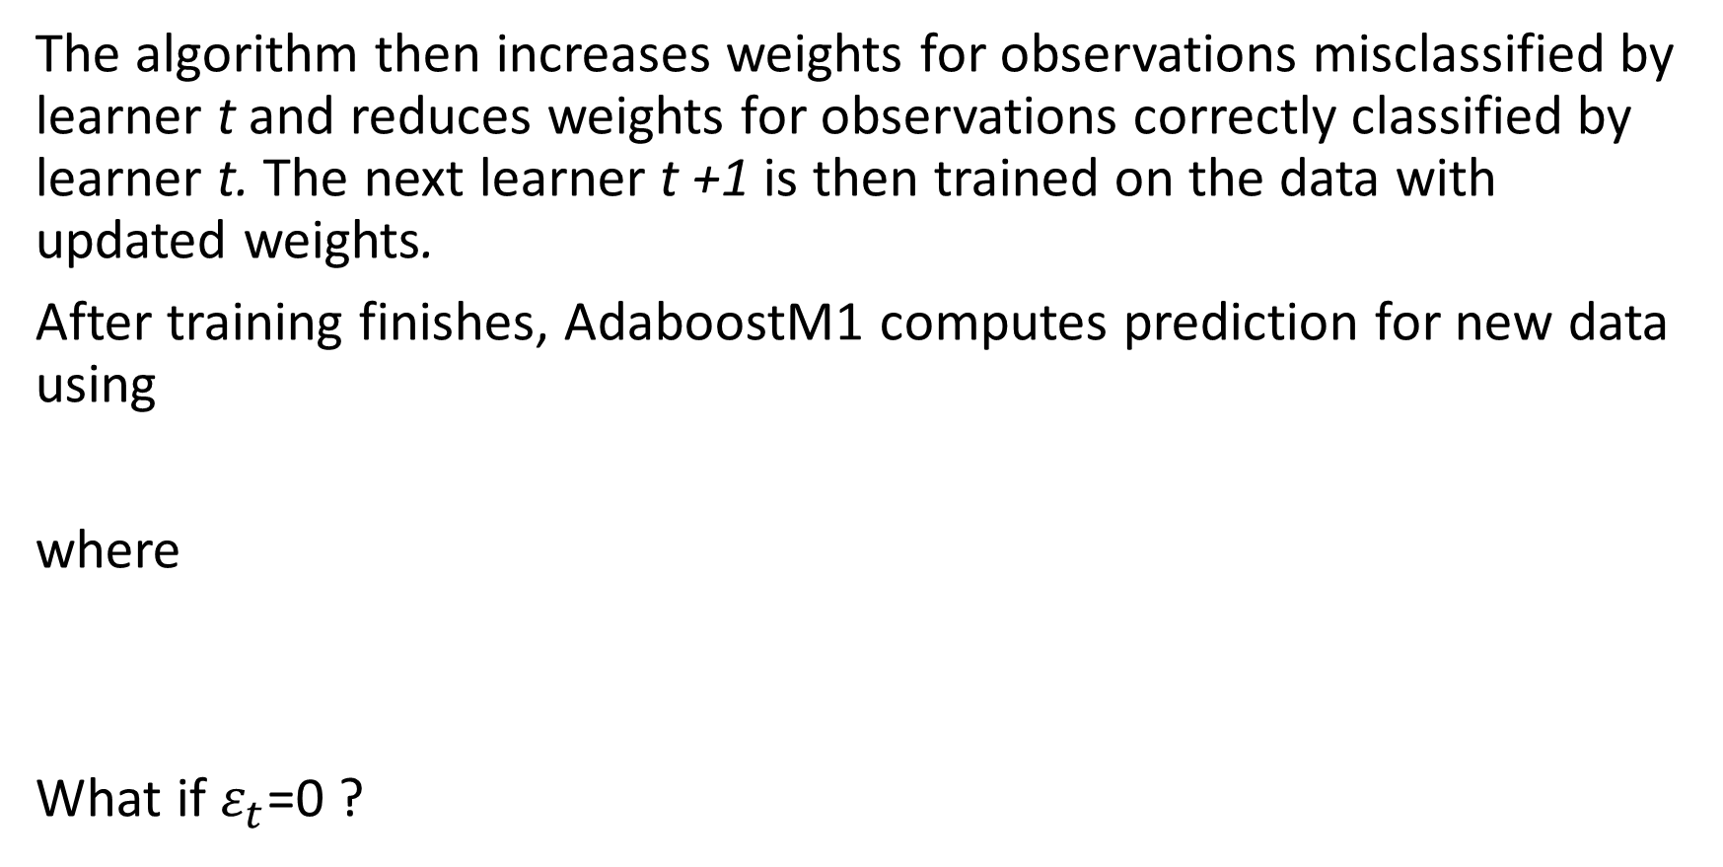
Boosting
The algorithm then increases weights for observations misclassified by learner t and reduces weights for observations correctly classified by learner t. The next learner t +1 is then trained on the data with updated weights.
After training finishes, AdaboostM1 computes prediction for new data using
where
What if $ε_{t}$=0 ?

Slide 16

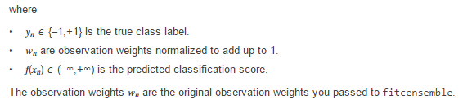
Boosting
Training by AdaboostM1 can be viewed as stepwise minimization of the exponential loss

Slide 17
Boosting
We see that the first base classifier y1(x) is trained using weighting coefficients that are all equal. In subsequent boosting rounds, the weighting coefficients are increased for data points that are misclassified and decreased for data points that are correctly classified.
The quantity epsilon represents a weighted error rate of each of the base classifiers. Therefore, the weighting coefficients alpha give greater weight to the more accurate classifiers.

Slide 18
Hierarchy of Ensemble Methods for Trees
Classiﬁcation Trees
• Bagging: Averaging Trees
• Random Forests: Cleverer Averaging of Trees
• Boosting: Cleverest Averaging of Trees
Methods for improving the performance of weak learners such as Trees. Classiﬁcation trees are adaptive, but do not generalize well.

Slide 19



Ornstein-Uhlenbeck
Ornstein Uhlenbeck

Slide 20
Ornstein-Uhlenbeck
Mu=0, sigma=0.05, theta= 0.1

